Slide 1
Hydraulic Machines
FUNDAMENTAL OF MECHANICAL ENGINEERING (UNIT - 4)

Slide 2
Syllabus
Working principles of hydraulic turbines and their classifications
Working principles of pumps and their classifications,
Hydraulic lift and their applications

Slide 3
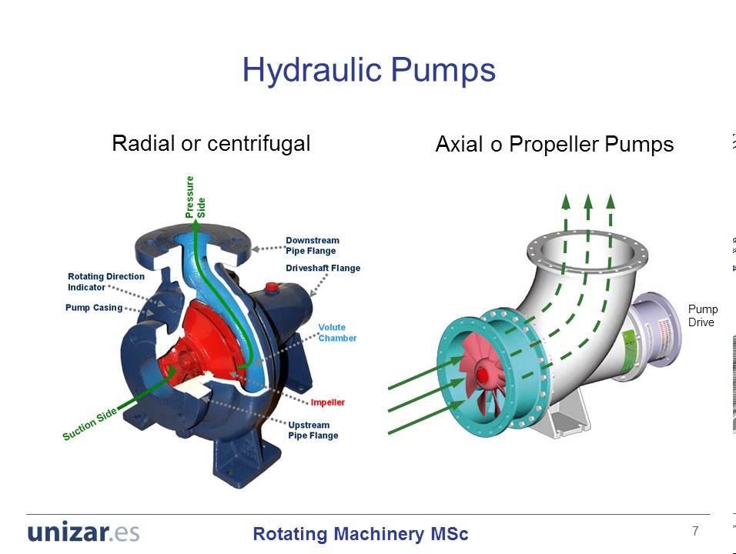
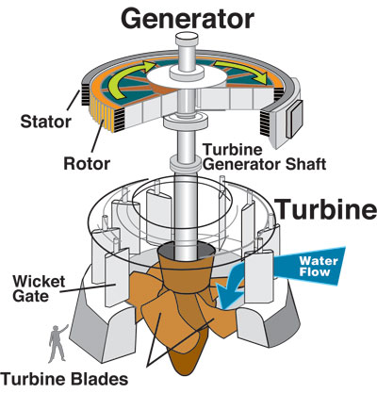
Introduction
Turbo machines are devices in which energy is transferred either to, or from, a continuously flowing fluid by the dynamic action of moving blades on the runner.

Slide 4
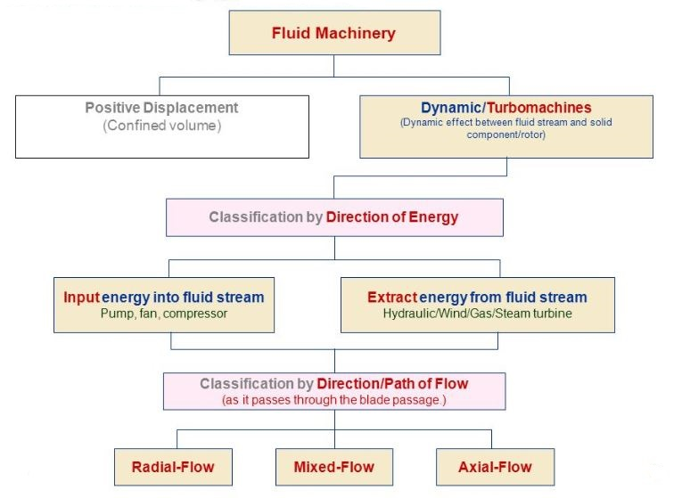
Classification of turbo machinery

Slide 5
Hydraulic Turbines
Hydraulic turbines are the machines which use the energy of water (hydro-power) and convert it into mechanical energy
As such these may be considered as hydraulic motors or prime-movers
The mechanical energy developed by a turbine is used in running an electric generator.

Slide 6
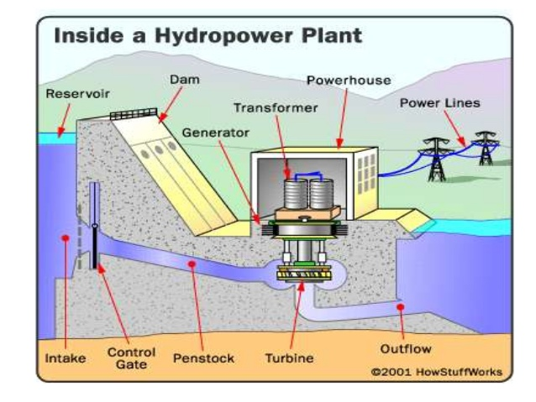
Hydro-power Plant

Slide 7
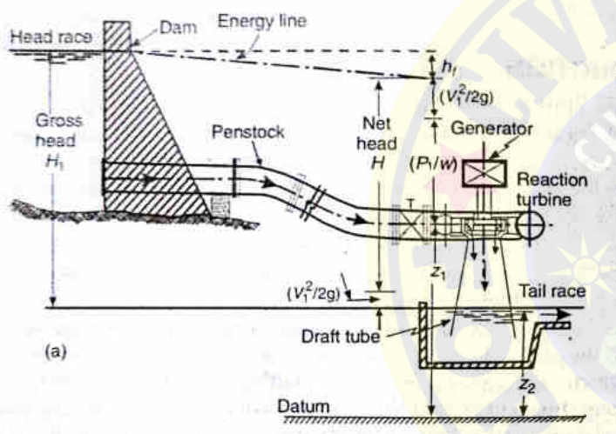
Elements of Hydroelectric PP
General layout of hydroelectric power plant

Slide 8
Classification of Turbines
On the basis of water entrance to turbine
Impulse Turbine (Pelton wheel)
reaction turbines (Francis, Kaplan, propeller )
On the basis of direction of flow of water in the runner
tangential flow turbine (Pelton wheel)
radial flow turbine (Francis turbine)
axial flow turbine (Kaplan, propeller turbine)
Mixed flow turbine (Modern Francis turbine)

Slide 9
Classification of Turbines (Contd.)
On the basis of head,
Low head (<60 m) --- (Kaplan, propeller)
medium head (60 – 250 m) --- (Francis turbine)
high head turbine (>250 m) --- (Pelton wheel)
On the basis of specific speed of turbine (and quantity of water required)
Low ( (8.5 – 30 rpm) – (Pelton wheel)
Medium ( (50-340 rpm) – (Francis turbine)
High ( (250-850 rpm) – (Kaplan, propeller turbine)

Slide 10
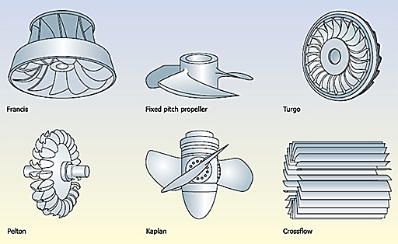

Slide 11
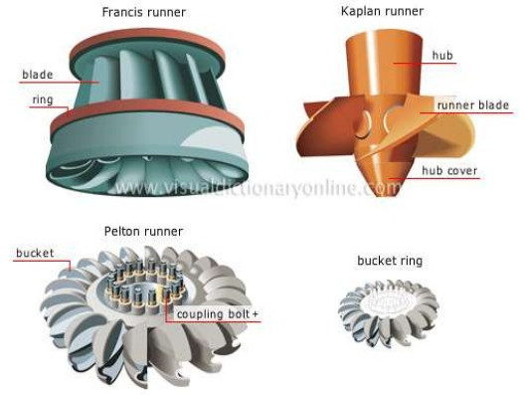

Slide 12
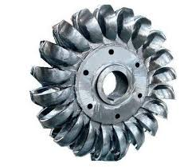
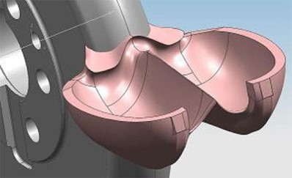
Pelton Wheel (tangential flow impulse turbine)

Slide 13
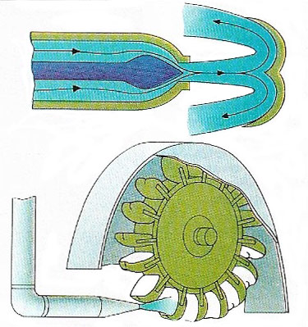
the flow is tangential to the runner and the available energy at the entrance is completely kinetic energy
it is preferred at a very high head and low discharges with low specific speeds
The pressure available at the inlet and the outlet is atmospheric

Slide 14
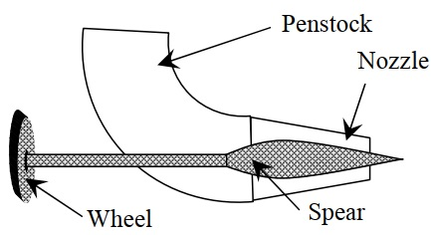
Nozzle and flow regulating arrangement
The amount of water striking
the vanes is controlled by the
forward and backward motion
of the spear.
Runner with buckets
The buckets are made of cast-iron cast-steel, bronze or stainless steel depending upon the head at the inlet of the turbine. The water jet strikes the bucket on the splitter of the bucket and gets deflected through 160°-170°

Slide 15
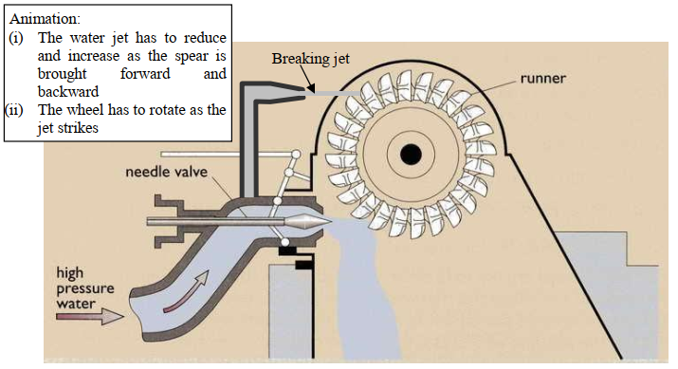
Casing
It is made of cast-iron or fabricated steel plates. The main function of the casing is to prevent splashing of water and to discharge the water into tailrace.
Breaking jet
When the jet of water is completely closed by pushing the spear in the forward direction than the amount of water striking the runner becomes zero. But still, the runner keeps moving due to the inertia of the runner.
In order to stop the runner in the shortest possible time, a small nozzle is provided which directs the jet of water at the back of the vanes. This jet of water used to stop the runner of the turbine is called breaking jet.

Slide 16
Working of Pelton Wheel
The water is drawn from the high-pressure source through a long pipe called a penstock.
The nozzle arrangement at the end of the pressure pipe helps the water to accelerate and it flows out as a high-speed jet at high velocity and discharges at atmospheric pressure.
The jet will hit the splitter of the buckets which will distribute the jet into two halves of the bucket and the wheel starts revolving.
The kinetic energy of the jet is reduced when it hits the bucket and also due to the spherical shape of buckets the directed jet will change its direction and takes a U-turn and falls into the tailrace.
In general, the inlet angle of the jet is between 1° to 3°, after hitting the buckets the deflected jet angle is between 165° to 170°.
The water collected in the tailrace should not submerge the Pelton wheel in any case.
To generate more power, two Pelton wheels can be arranged to a single shaft or two water jets can be directed at a time to a single Pelton wheel.

Slide 17
Advantages Of Pelton Turbine
It is easy to maintain.
There is no cavitation problem in the Pelton turbine.
Pelton turbine has a simple construction.
It can work on the high head and low discharge.
It is very easy to assemble.
The overall efficiency of this turbine is very high.
Disadvantages Of Pelton Turbine
Pelton Turbine requires a very high head for operation.
The efficiency decreases quickly with time.
Its turbine size is generally large and hence requires a large space.
As it only works in the high head, it is difficult to control vibrations in the operating head.

Slide 18
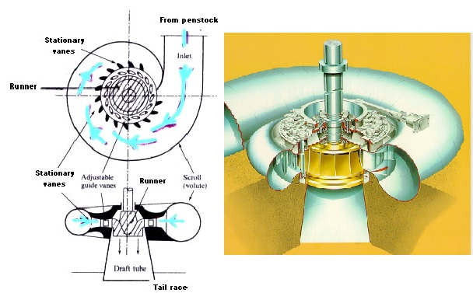
REACTION TURBINES

Slide 19
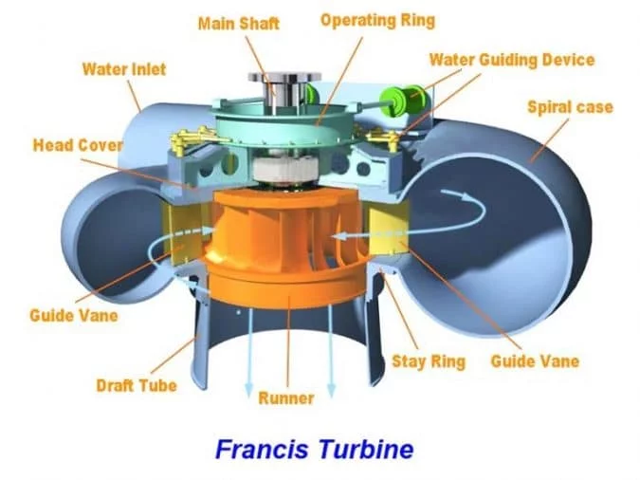
Francis Turbine It’s a mixed flow type reaction turbine. In it water enters radially at its outer periphery and leaves axially at its center.

Slide 20
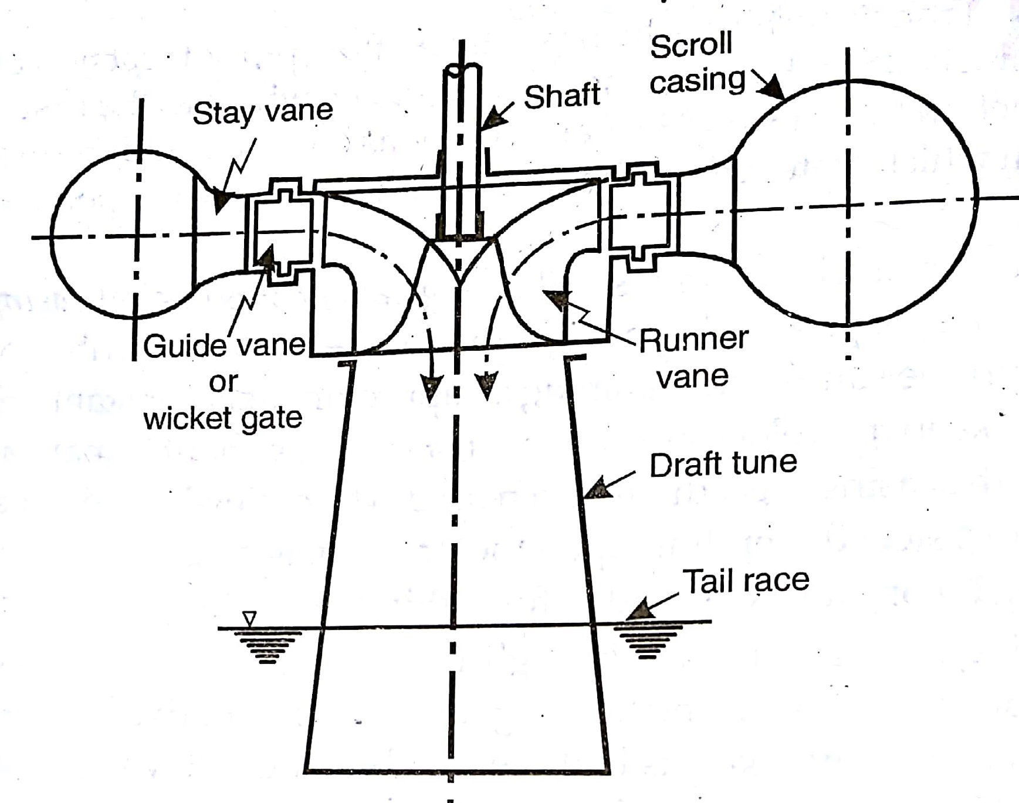
Components
Scroll Casing
Stay Vanes
Guide Vanes
Runner Vanes
Draft Tube

Slide 21
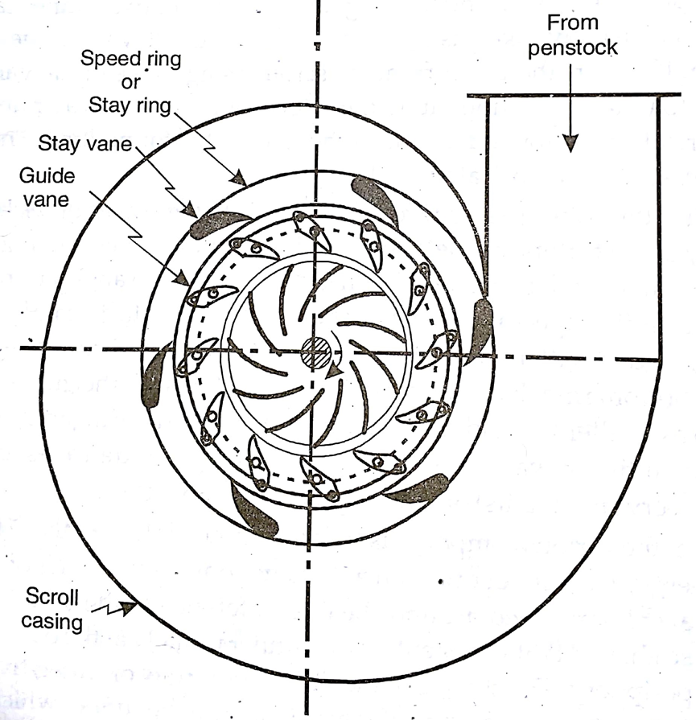

Slide 22
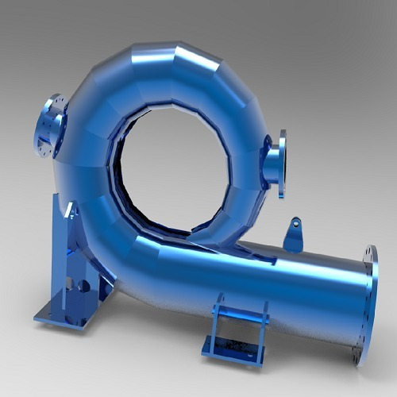
Casing
The purpose of the casing is to provide an even distribution of water around the circumference of the turbine runner
In order to keep the velocity of the water constant throughout its path around the runner, the cross sectional area of the casing is gradually decreased.
The casing is made up of cast steel, plate steel, concrete or concrete-steel

Slide 23
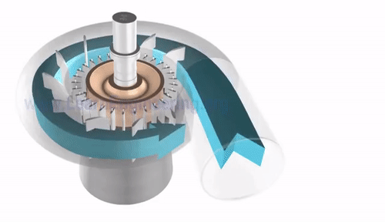
Vanes
Stay Vanes: It directs the water from casing to the guide vanes. Its number is usually taken as half the number of guide vanes. These are usually made of cast iron or cast steel.
Guide Vanes or Wicket Vanes: Its function is to regulate the quantity of water supplied to the runner and to direct water onto the runner at an appropriate angle.
Guide vanes are of airfoil shape to reduce friction losses and proper pressure variation.
Guide vanes are operated either by means of a wheel or automatically by a governor.

Slide 24
Runner Vane: The runner of Francis turbine consists of a series of curved vanes (16 – 24 in no.) evenly arranged around the circumference of turbine shaft.
The vanes are so shaped that the water enters the runner radially at the outer periphery and leaves it axially at the inner periphery.
The change in the direction of flow produces centrifugal action on the runner.

Slide 25
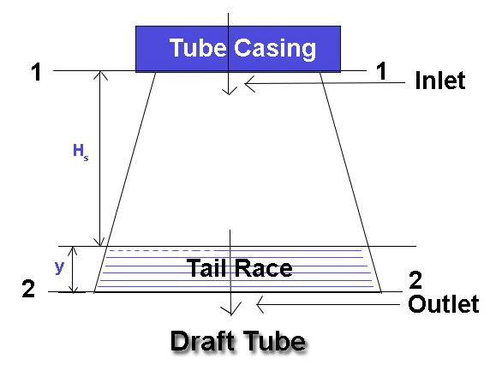
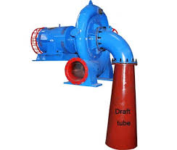
Draft Tube
Draft Tube is a connecting pipe which is fitted generally at the outlet or exit of turbines which and convert kinetic energy of water at outlet of turbine to static pressure. It helps to avoid wastage of kinetic energy of water that flow from the outlet of turbines.
It is generally fitted in the power turbines like reaction turbines, Kaplan turbines or Francis turbines.
The diameter of draft tube is small near the inlet and large near its outlet. The outlet of draft tube is always submerged in water.

Slide 26
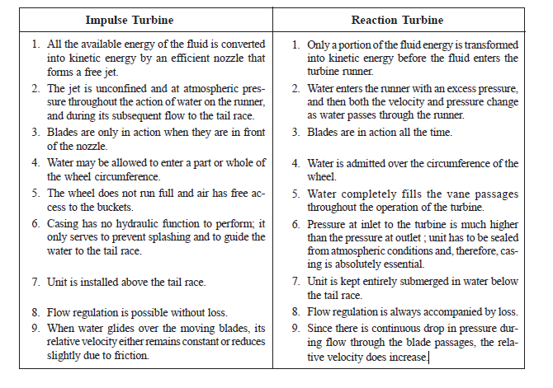
Impulse Vs Reaction Turbine

Slide 27
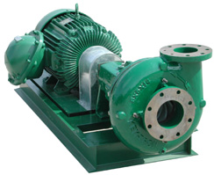
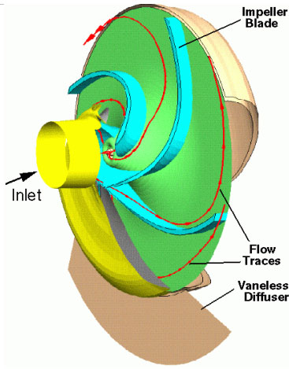
Hydraulic Pumps
A hydraulic pump is a mechanical source of power that converts mechanical power into hydraulic energy (hydrostatic energy i.e. flow, pressure)
They are used to move water from lower points to higher points with a required discharge and pressure head.
When a hydraulic pump operates, it creates a vacuum at the pump inlet, which forces liquid from the reservoir into the inlet line to the pump and by mechanical action delivers this liquid to the pump outlet and forces it into the hydraulic system.

Slide 28
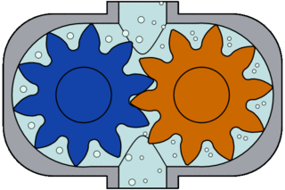
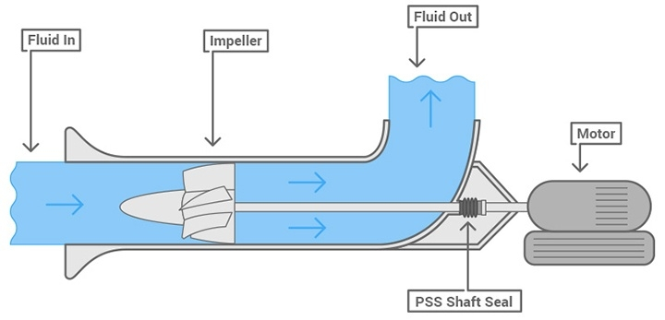
Classification of Pumps
Pumps
Hydrostatic
or
positive displacement pumps
Hydrodynamic pumps
Rotary
Reciprocating
Centrifugal
Axial
Rotary Pump (GEAR PUMP)
Axial Pump

Slide 29
This classification is based on the way the water leaves the rotating part of the pump.
In radial-flow pump the water leaves the impeller in radial direction,
while in the axial-flow pump the water leaves the propeller in the axial direction.
In the mixed-flow pump the water leaves the impeller in an inclined direction having both radial and axial components

Slide 30
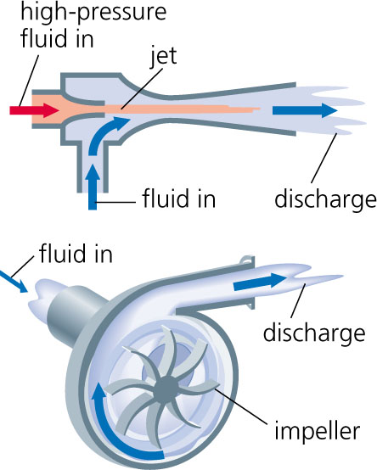
Centrifugal Pump:
Centrifugal pumps are used to transport fluids by the conversion of rotational kinetic energy to the hydrodynamic energy of the fluid flow.
The rotational energy typically comes from an engine or electric motor.
Working principle
Centrifugal pumps are used to induce flow or raise a liquid from a low level to a high level. These pumps work on a very simple mechanism.
A centrifugal pump converts rotational energy, often from a motor, to energy in a moving fluid.

Slide 31
Working principle (continued)
The two main parts that are responsible for the conversion of energy are the impeller and the casing.
The impeller is the rotating part of the pump and the casing is the airtight passage which surrounds the impeller.
In a centrifugal pump, fluid enters into the casing, falls on the impeller blades at the eye of the impeller, and is whirled tangentially and radially outward until it leaves the impeller into the diffuser part of the casing.
While passing through the impeller, the fluid is gaining both velocity and pressure.

Slide 32
Main Parts of Centrifugal Pumps
Impeller:
It is the rotating part of the centrifugal pump.
It consists of a series of backwards curved vanes (blades).
The impeller is driven by a shaft which is connected to the shaft of an electric motor.

Slide 33
Main Parts of Centrifugal Pumps
Casing
It is an air-tight passage surrounding the impeller
designed to direct the liquid to the impeller and lead it away
Volute casing. It is of spiral type in which the area of the flow increases gradually.

Slide 34
Suction Pipe: This pipe connects the water in the sump to the eye of the impeller. At the bottom end of the pipe, a non- return valve is attached which opens only in upward direction. Thus this valve prevents the water draining to the sump.
Delivery Pipe: This pipe delivers the liquid from the output of the impeller to the required height.
The Shaft: which is the bar by which the power is transmitted from the motor drive to the impeller.
The driving motor: which is responsible for rotating the shaft. It can be mounted directly on the pump, above it, or adjacent to it.

Slide 35
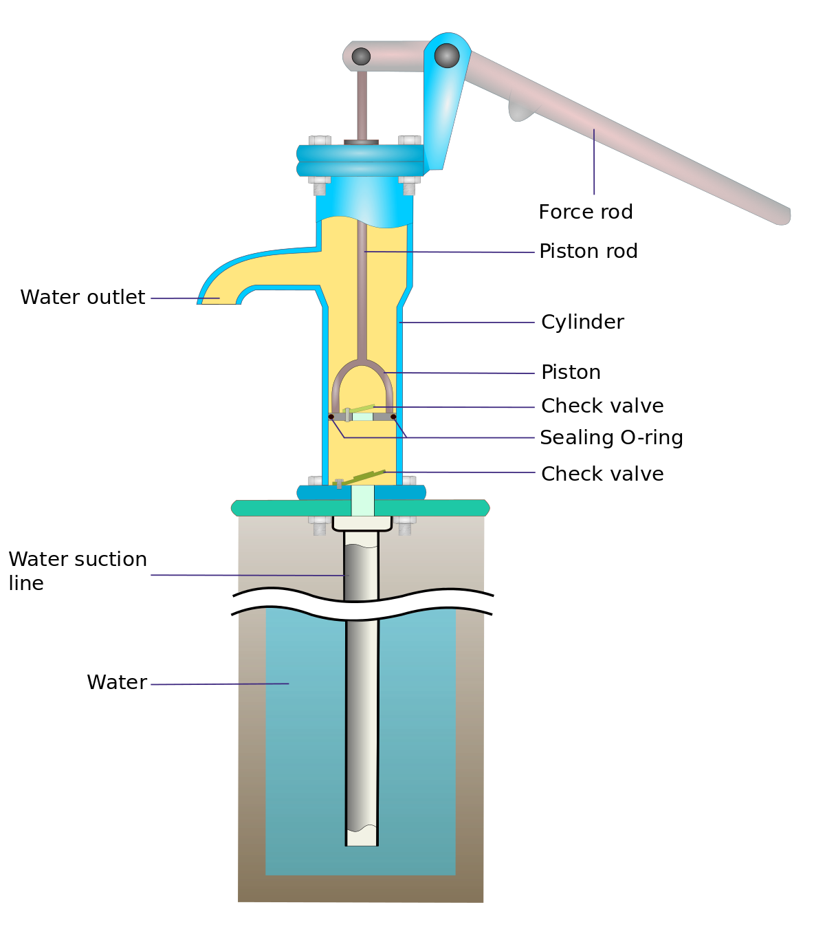
Reciprocating Pump
Reciprocating pump is a positive displacement pump where certain volume of liquid is collected in enclosed volume and is discharged using pressure to the required application.
Reciprocating pumps are more suitable for low volumes of flow at high pressures.

Slide 36
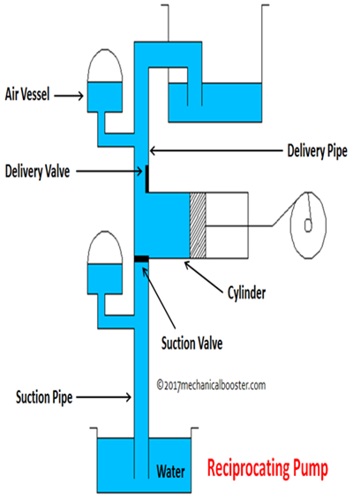
Components of Reciprocating Pump
The main components of reciprocating pump are as follows:
Suction Pipe
Suction Valve
Delivery Pipe
Delivery Valve
Cylinder
Piston and Piston Rod
Crank and Connecting Rod
Strainer
Air Vessel

Slide 37
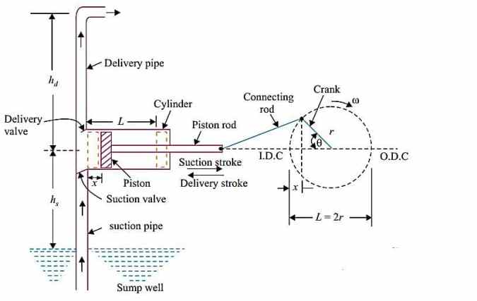

Slide 38
Suction Pipe- Suction pipe connects the source of liquid to the cylinder of the reciprocating pump. The liquid is suck by this pipe from the source to the cylinder.
Suction Valve- Suction valve is non-return valve which means only one directional flow is possible in this type of valve. This is placed between suction pipe inlet and cylinder. During suction of liquid it is opened and during discharge it is closed.
Delivery Pipe- Delivery pipe connects cylinder of pump to the outlet source. The liquid is delivered to desired outlet location through this pipe.
Delivery Valve- Delivery valve also non-return valve placed between cylinder and delivery pipe outlet. It is in closed position during suction and in opened position during discharging of liquid.
Cylinder- A hollow cylinder made of steel alloy or cast iron. Arrangement of piston and piston rod is inside this cylinder. Suction and release of liquid is takes place in this so, both suction and delivery pipes along with valves are connected to this cylinder.

Slide 39
Piston and Piston Rod- Piston is a solid type cylinder part which moves backward and forward inside the hollow cylinder to perform suction and deliverance of liquid. Piston rod helps the piston to its linear motion.
Crank and Connecting Rod- Crank is a solid circular disc which is connected to power source like motor, engine etc. for its rotation. Connecting rod connects the crank to the piston as a result the rotational motion of crank gets converted into linear motion of the piston.
Strainer- Strainer is provided at the end of suction pipe to prevent the entrance of solids from water source into the cylinder.
Air Vessel- Air vessels are connected to both suction and delivery pipes to eliminate the frictional head and to give uniform discharge rate.

Slide 40
Working of Reciprocating Pump
When the power source is connected to crank, the crank will start rotating and connecting rod also displaced along with crank.
The piston connected to the connecting rod will move in linear direction. If crank moves outwards then the piston moves towards its right and create vacuum in the cylinder.
This vacuum causes suction valve to open and liquid from the source is forcibly sucked by the suction pipe into the cylinder.
When the crank moves inwards or towards the cylinder, the piston will move towards its left and compresses the liquid in the cylinder.
Now, the pressure makes the delivery valve to open and liquid will discharge through delivery pipe.
When piston reaches its extreme left position whole liquid present in the cylinder is delivered through delivery valve.
Then again the crank rotate outwards and piston moves right to create suction and the whole process is repeated.

Slide 41
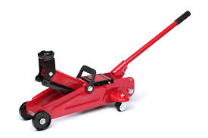
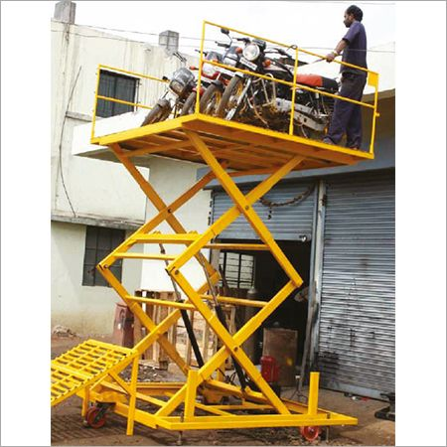
Hydraulic Lift
A hydraulic lift is a type of machine that uses a hydraulic apparatus to lift or move objects using the force created when pressure is exerted on liquid in a piston. Force then produces "lift" and "work.“
It is often implemented to operate heavy machinery or to move and lift heavy and large objects like cars, dirt and shipping containers.
A hydraulic device used for carrying persons and loads from one floor to another, in a multi - storeyed building
These are mainly of two types:
Direct Acting hydraulic lift
Suspended hydraulic lift

Slide 42
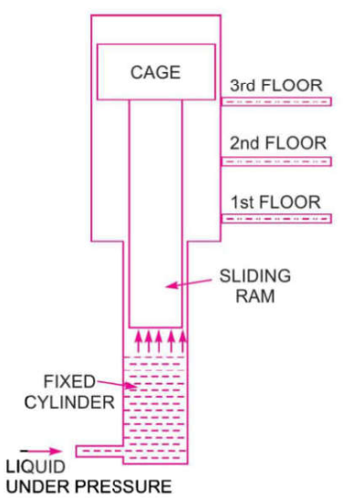
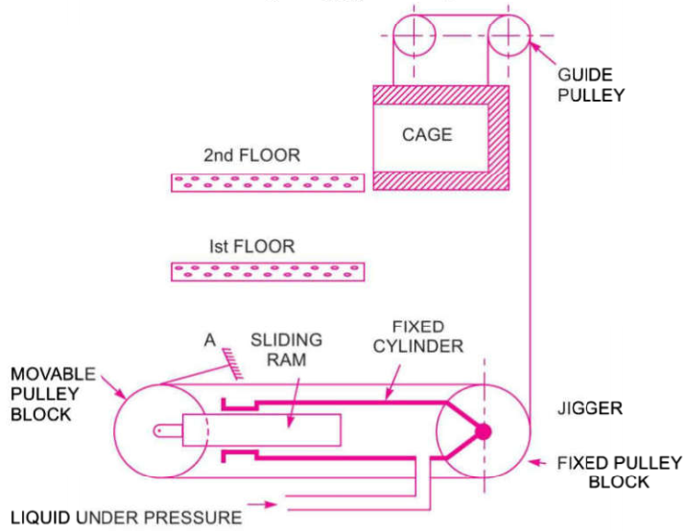
Direct Acting hydraulic lift Suspended hydraulic lift

Slide 43
A direct acting hydraulic lift is fixed cylinder, meaning it is set in the wall or floor and a piston or sliding ram moves in and out of it when we apply pressure. It’s cage, where the load is placed, is fitted on top of the sliding ram, which is itself fitted in the previously mentioned fixed cylinder which moves reciprocally, in an upwards or downwards direction, when the pressure is applied.
Pressurized fluid is forced into the cylinder and pushes the ram upwards. The platform carries loads or passengers and moves between the floors. The main operating principle of a direct acting hydraulic lift is to have the stroke of the ram be equal to the lift of the cage.
The second style of hydraulic lift is the suspended hydraulic lift. The main difference between this style and a direct acting one is the presence of wire rope, pulleys and hydraulic jiggers. The wire rope connects the cage to the pulleys, which are themselves connected to the sliding ram and fixed cylinder; one pulley is fixed and the other moveable. The hydraulic jigger is essentially a moving ram which slides inside a fixed hydraulic cylinder.
When pressurized fluid is forced into the cylinder, it causes the ram to promote action with the pulleys. The hydraulic jigger rotates the pulleys and the wire rope allows the cage to maintain the pressure force with the floor.

Slide 44


